Slide 1
World Happiness Report
Presented By
Name : S.MUTHU SIVA
College name : Jayaraj annapackiam CSI college of engineering
Department : Mechanical engineering

Slide 2
OUTLINE
Problem Statement
Proposed System/Solution
System Development Approach
Algorithm & Deployment
Result
Conclusion
Future Scope
References

Slide 3
Problem Statement
The World Happiness Report measures global happiness based on a range of factors, including economic, social, and environmental indicators. Despite significant advances in understanding the determinants of happiness, there is a need for deeper insights into the socio-economic disparities that contribute to variations in happiness across different regions and demographics. This problem leads to critical questions about how governments, policymakers, and communities can address these disparities to promote greater well-being and happiness for all. How can we develop more effective strategies to reduce the happiness gap, foster social cohesion, and create environments where all individuals can thrive emotionally and socially? By exploring the underlying causes of happiness disparities, we can better inform public policy and promote a more inclusive approach to enhancing global well-being

Slide 4
Proposed Solution
Broaden the Scope of Happiness Metrics The World Happiness Report relies on a wide array of indicators. To make the report more comprehensive, it's essential to include additional metrics that measure environmental sustainability, cultural diversity, and worklife balance.
Promote Inclusivity and Social Equity Inclusive policies that reduce disparities across gender, race, ethnicity, and socio-economic status can lead to greater societal happiness. Encouraging governments to focus on social equity can enhance overall well-being.
Encourage National and Local-Level Participation Encourage governments to use the World Happiness Report as a guide for shaping national and local policies. Localized studies could provide more nuanced data and specific insights, fostering a greater impact at the grassroots level.
Integrate Environmental Sustainability Since environmental factors play a significant role in quality of life, the report should highlight the importance of sustainability and encourage countries to adopt green policies. Initiatives to measure and reduce a country's carbon footprint can improve both environmental health and human well-being.
Emphasize Mental Health and Wellness Highlighting mental health as a key factor in happiness can encourage countries to prioritize mental wellness programs. This could involve better access to mental health services, education, and destigmatization of mental health issues.
Increase Global Collaboration Facilitating knowledge-sharing among nations and international organizations can help countries learn from each other's successful happiness-related policies. This could include workshops, conferences, and case studies that focus on the strategies yielding the best outcomes

Slide 5
System Approach
1. Identify Core Components of Happiness The World Happiness Report typically measures happiness through six key variables: GDP per capita, social support, healthy life expectancy, freedom to make life choices, generosity, and perceptions of corruption. A systems approach starts by identifying these core components and understanding their relationships.
2.Map System Dynamics A system diagram or causal loop diagram can help map the interactions between different factors. Identify feedback loops, leverage points, and critical dependencies. For example, higher GDP per capita can lead to better healthcare, which in turn increases healthy life expectancy, potentially contributing to overall happiness
3. Understand the Influence of External Factors External factors such as global economic conditions, environmental issues, and political stability can significantly impact happiness. Consider these broader influences and how they affect the system. For example, climate change can affect food security and public health, impacting social support and life expectancy.
5. Integrate Stakeholder Input A systems approach values input from diverse stakeholders, including government agencies, businesses, NGOs, and citizens. By incorporating a wide range of perspectives, the system becomes more robust and adaptable to change. Engaging stakeholders through participatory decision-making ensures that policies align with the needs and values of the population.
6. Monitor and Adjust Continuous monitoring and adjustment are essential in a systems approach. Implement mechanisms to track changes in the system, assess policy impacts, and make adjustments as needed. This might involve regular surveys, data analysis and public consultations

Slide 6
Algorithm & Deployment
Algorithm Development
Define Key Metrics: Identify the metrics that will be used to measure happiness. Common metrics include GDP per capita, social support, healthy life expectancy, freedom to make life choices, generosity, and perceptions of corruption. Additional metrics could be environmental sustainability, work-life balance, education, and cultural diversity.
Collect and Preprocess Data: Gather data from reliable sources such as national statistical agencies, international organizations, and largescale surveys. The data should be cleaned, normalized, and formatted consistently to ensure comparability across countries and time periods.
Feature Engineering: Create derived features from existing data that may better represent happiness. This could involve calculating growth rates, standard deviations, or creating composite indices to capture complex concepts like social support or political stability.
Modeling and Analysis: Use statistical and machine learning techniques to analyze the data and create predictive models. Common techniques include regression analysis, decision trees, and neural networks. Consider ensemble methods to improve accuracy and robustness. The goal is to identify key drivers of happiness and predict happiness scores for each country.
Cross-Validation and Robustness Testing: Apply cross-validation techniques to ensure the reliability and generalization of the models. Test the models' robustness by introducing different variables or changing the dataset structure.

Slide 7
Deployment
Build a Scalable Infrastructure: Deploy the algorithm on a scalable infrastructure that can handle large datasets and multiple concurrent users. Cloud platforms like AWS, Google Cloud, or Azure are ideal for this purpose, offering scalability and flexibility.
Create an Interactive Platform: Develop a web-based platform where users can interact with the data, visualize results, and explore different scenarios. This platform should be user-friendly and accessible to a wide audience, including policymakers, researchers, and the general public.
Implement Security and Data Privacy: Ensure that the deployment infrastructure adheres to best practices for security and data privacy. This includes encryption of sensitive data, secure authentication mechanisms, and compliance with regulations like GDPR.
Enable Continuous Updates: Design the deployment to support continuous updates as new data becomes available. This requires automated data pipelines, monitoring systems, and update mechanisms to keep the platform up-to-date with the latest information.
Integrate Feedback Mechanisms: Allow users to provide feedback on the platform and the underlying algorithm. This feedback can be used to refine the algorithm, improve the user experience, and ensure that the platform meets the needs of its users.
Facilitate Collaboration and Sharing: Enable collaboration among stakeholders by providing tools for sharing insights, data, and reports. This can help foster a community of practice around the World Happiness Report, encouraging knowledge exchange and joint problem-solving

Slide 8

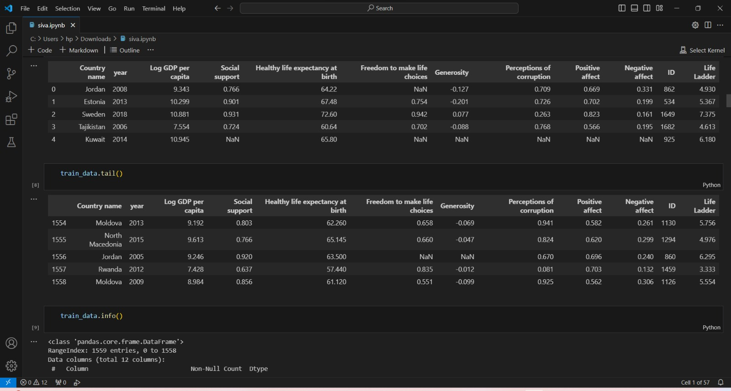
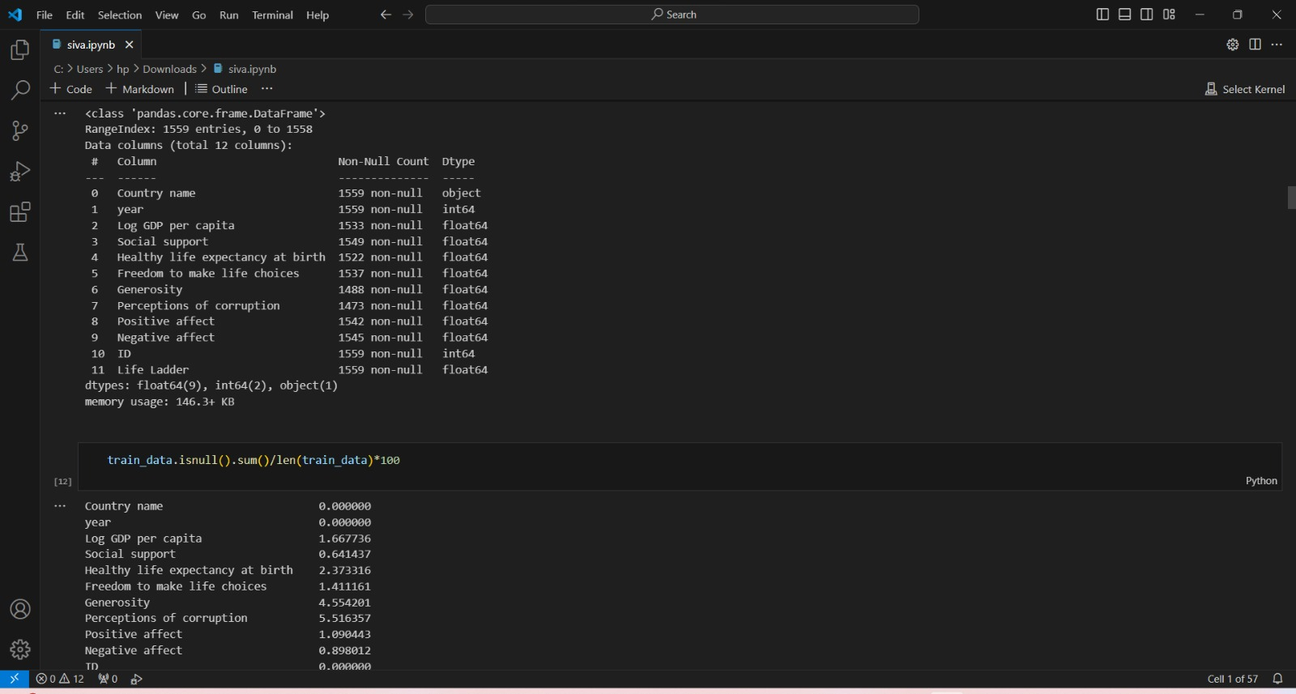

Result

Slide 9
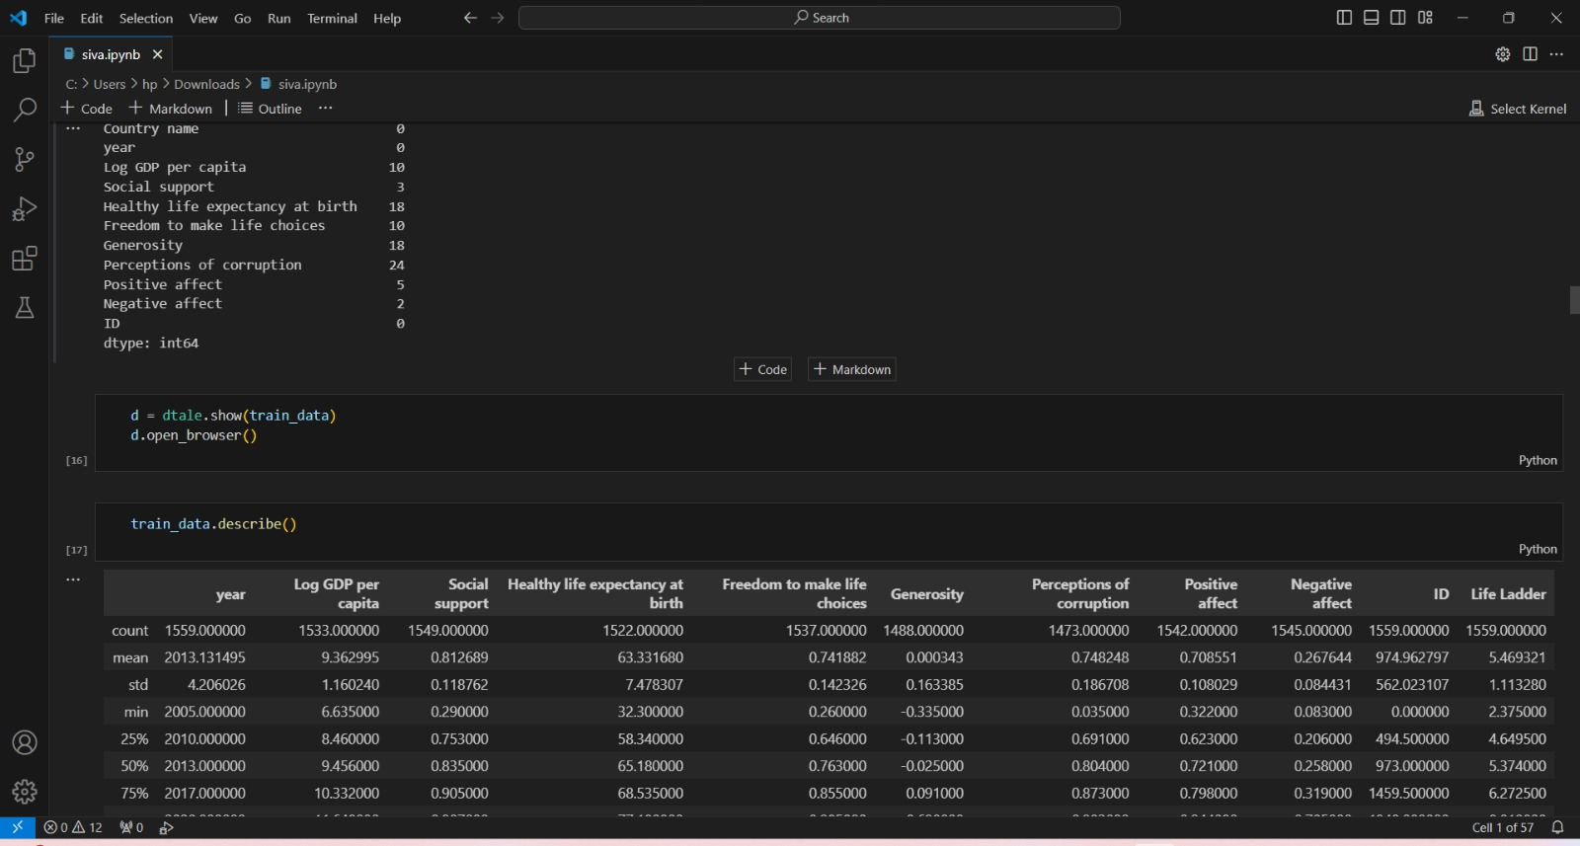
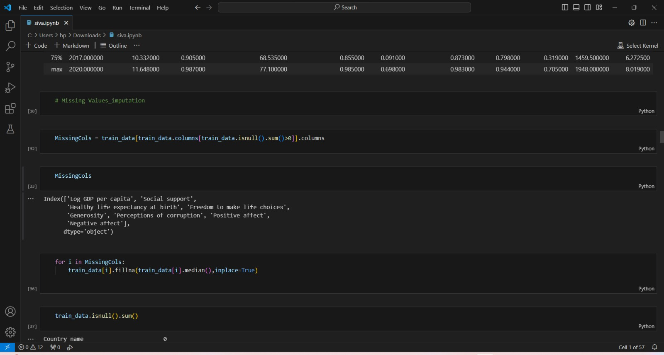
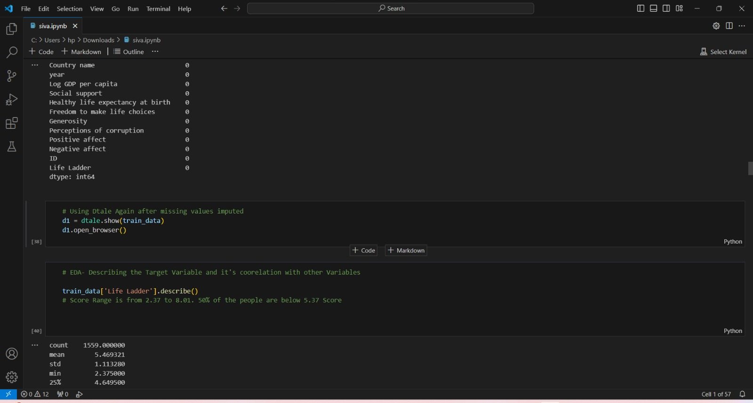
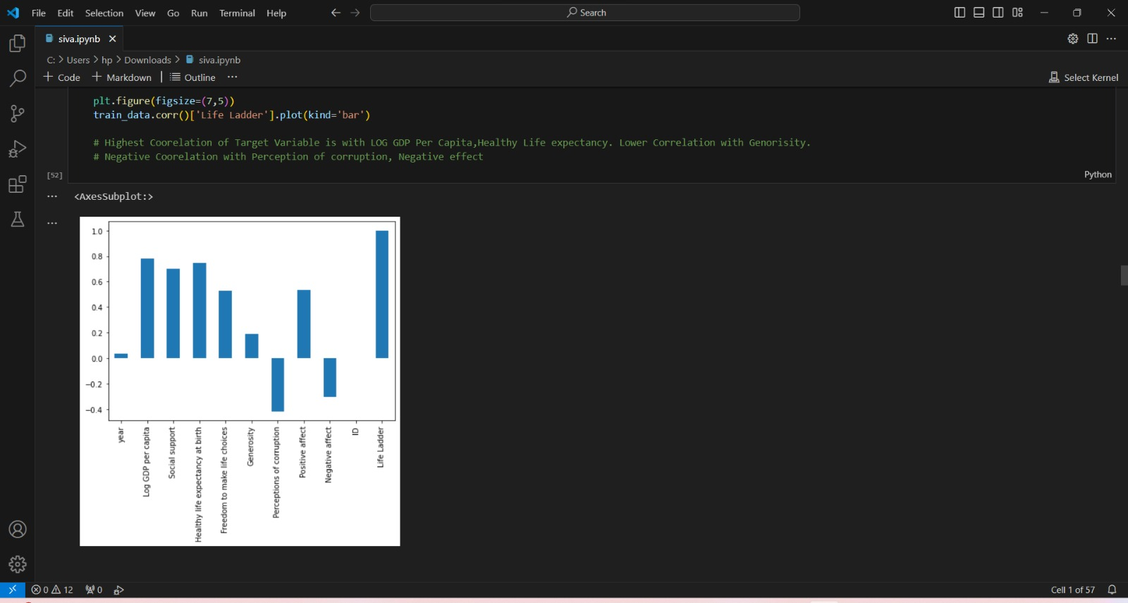

Slide 10
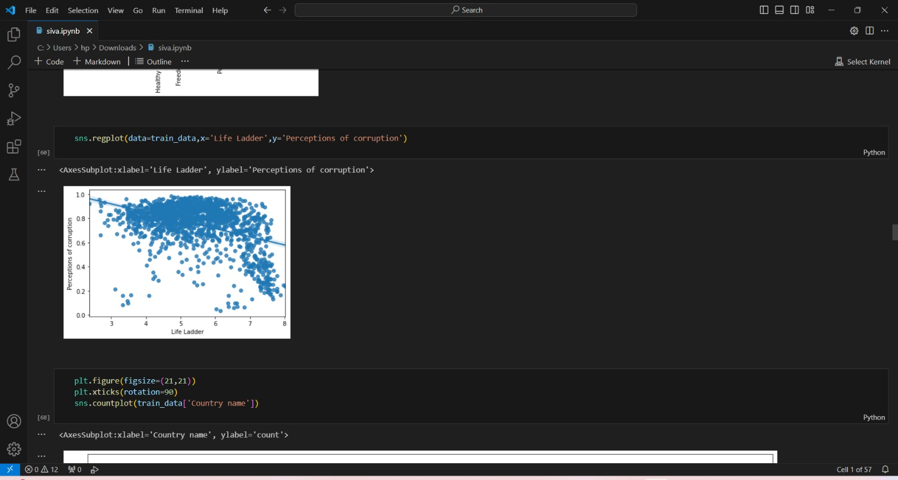
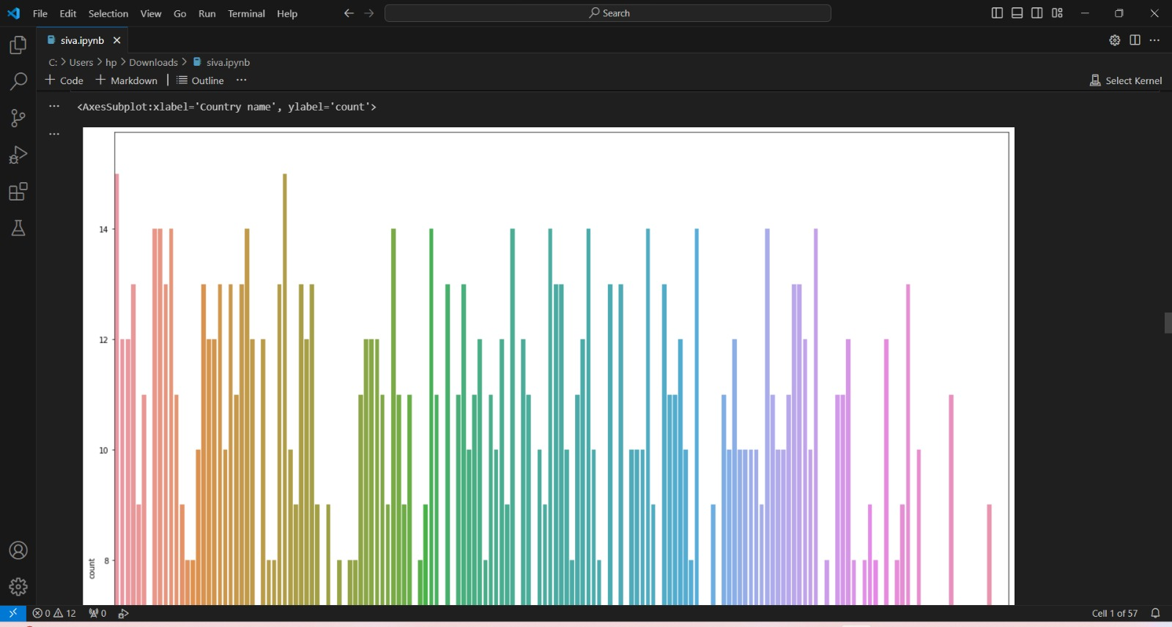
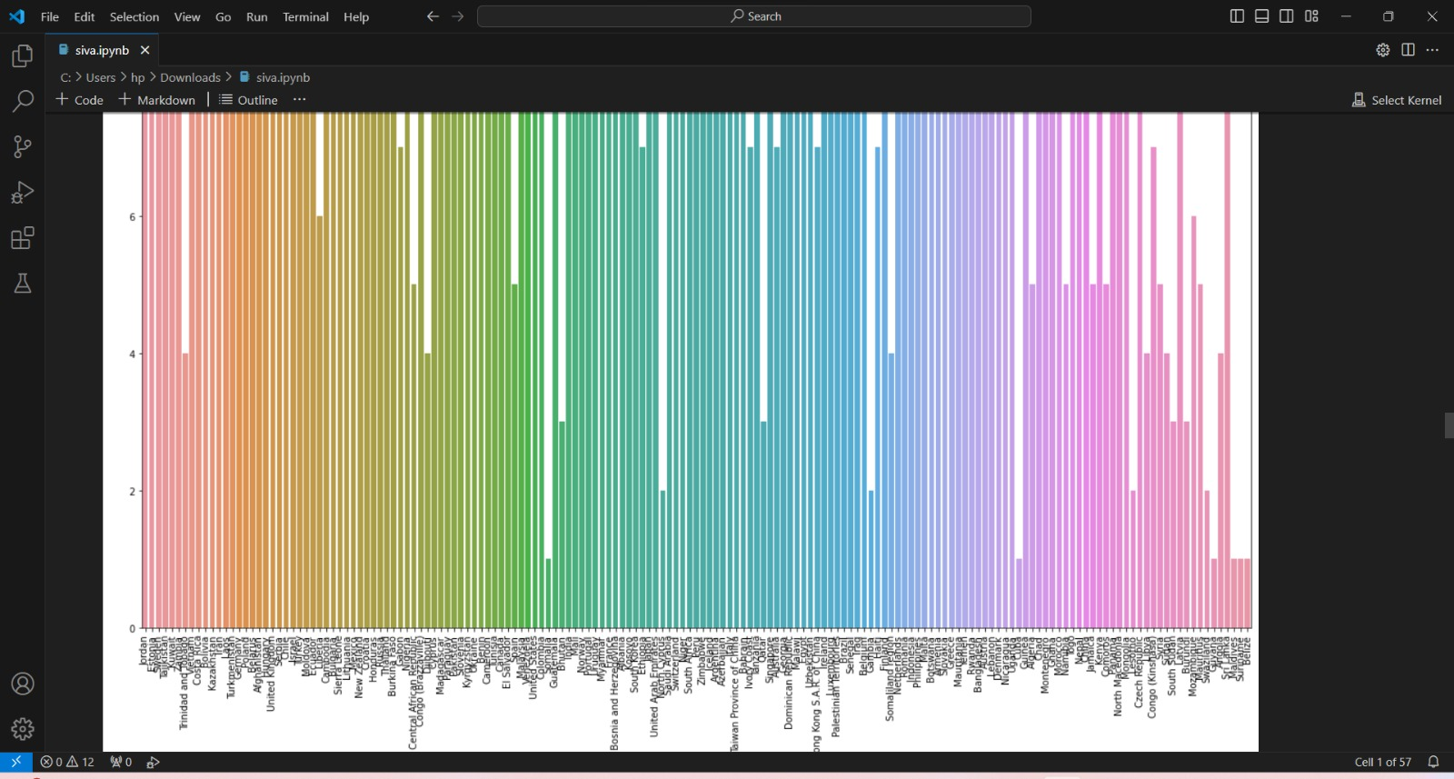
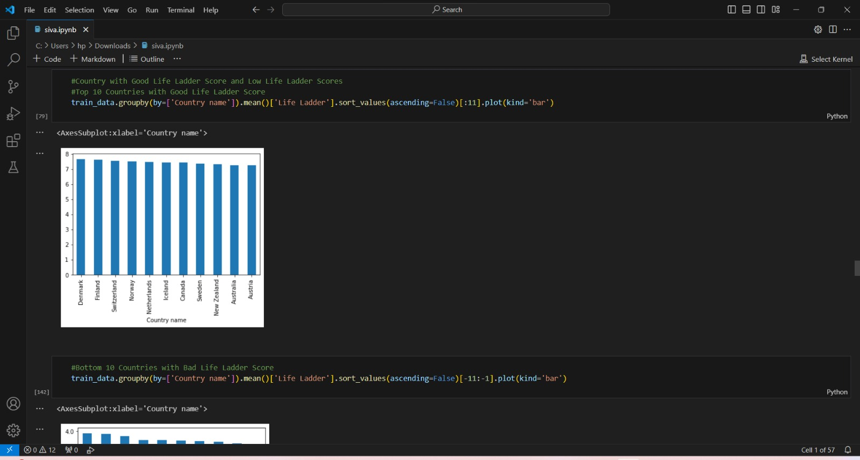

Slide 11
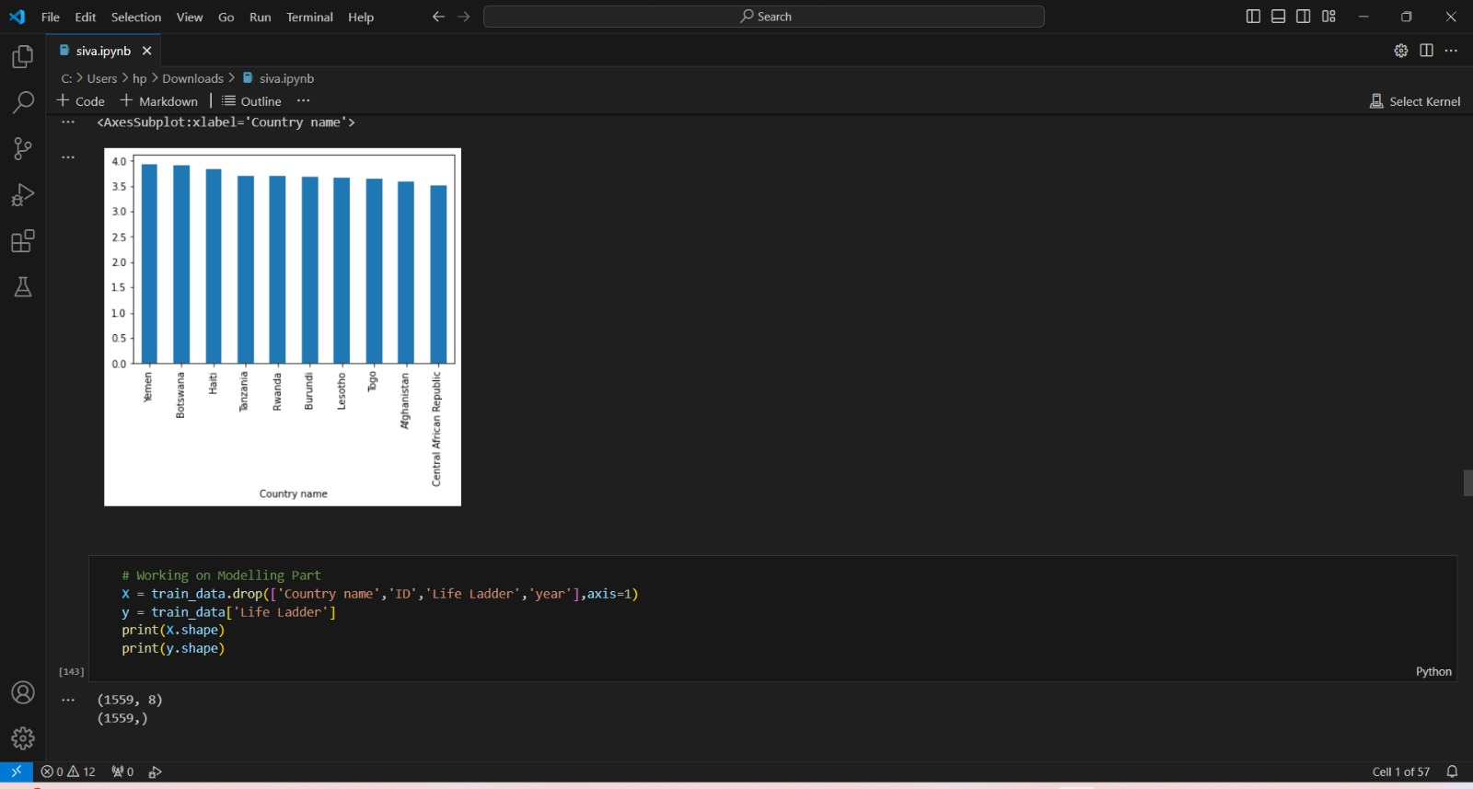


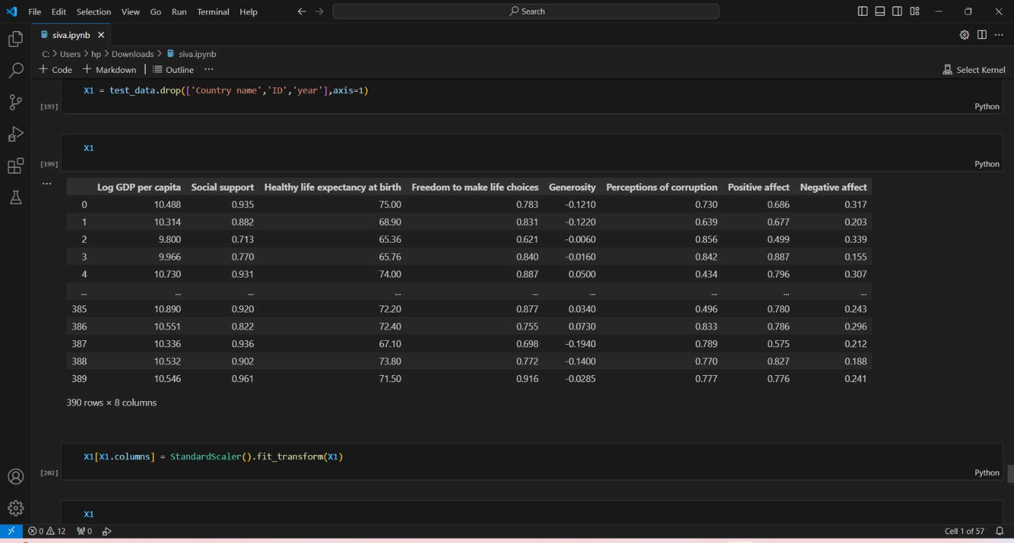

Slide 12
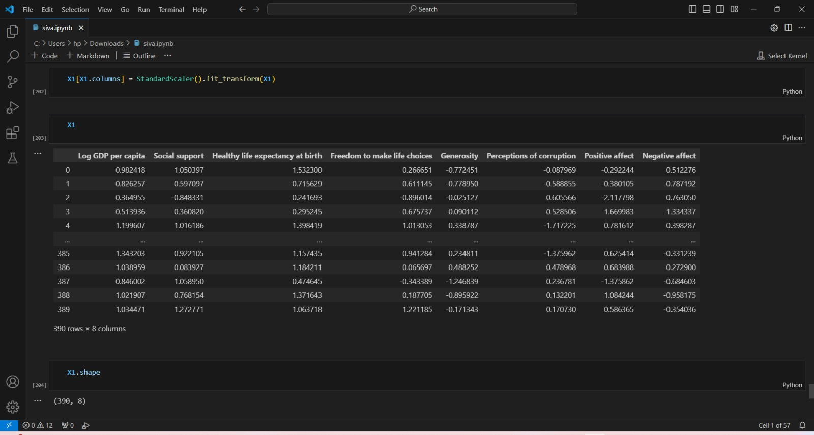


Slide 13
Conclusion
Income and Wealth: Economic stability and prosperity are crucial for providing a base for happiness
Social Support: Having reliable social networks and a sense of community contributes to well-being.
Life Expectancy and Health: Longer life expectancy and better health services are important indicators.
Freedom of Choice: The ability to make life choices freely impacts overall happiness.
Generosity: A culture of giving and altruism is linked with higher happiness.
Absence of Corruption: Societies with lower levels of corruption tend to have higher levels of happiness
The report provides insights into the different elements that contribute to happiness in various cultures and regions, indicating that it's not just wealth but a combination of multiple factors that lead to a happier society
A key takeaway is that countries with comprehensive social support systems, robust healthcare, strong democratic values, and community engagement tend to score high on the happiness index. The report encourages policymakers to focus on these areas to foster greater well-being among their populations.

Slide 14
Future scope
Expanded Data Sources : Incorporating more varied data sources, such as social media trends, mobile data, and new surveys, could provide a more detailed and nuanced view of global happiness.
In-Depth Regional Analysis : Future reports could delve deeper into specific regions, providing tailored recommendations for improving happiness in different cultural and geographical contexts.
Focus on Sustainability : With growing concern about environmental sustainability, future reports could examine the relationship between happiness and sustainable practices, exploring how environmental factors influence well-being.
Dynamic Measurements : Considering that happiness is influenced by rapidly changing factors, developing more dynamic metrics could help capture shifts in happiness over shorter time frames, allowing for more timely insights.
Integration with Policy : The report could work more closely with governments and international organizations to implement findings into concrete policy changes, helping to translate insights into actionable results.
Longitudinal Studies : Longer-term studies could track the same individuals or regions over time to understand how happiness evolves and what factors have lasting impacts.

Slide 15
References
Official Website : The primary source for all editions of the report, offering complete access to the current and past reports, methodologies, and data analysis. The World Happiness Report is typically published by the Sustainable Development Solutions Network (SDSN).
Academic Articles and Journals : Scholars often analyze and discuss the findings from the World Happiness Report. Using academic databases such as JSTOR, PubMed, or Google Scholar can provide a deeper understanding of the methodologies and interpretations behind the report.
News Articles : Reputable news organizations often cover the World Happiness Report, providing summaries, highlights, and contextual analysis of the findings.
Research Institutes and Think Tanks : Organizations focused on well-being, social sciences, and public policy might reference the report in their work, offering additional insights into its implications.

Slide 16
THANK YOU

